Slide 1
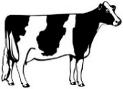
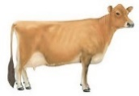
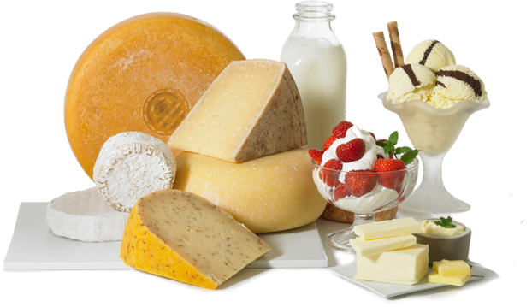
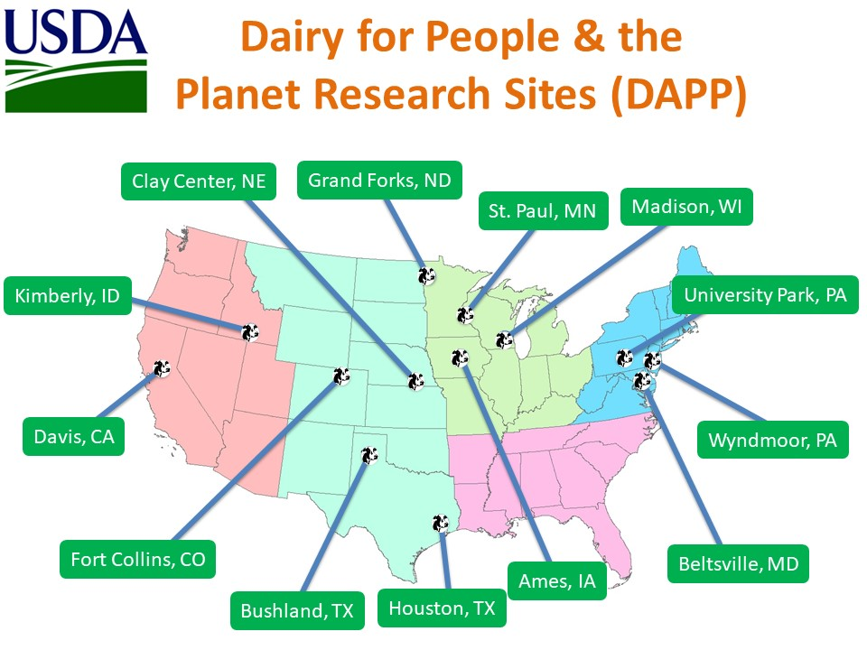
Figure 1: The Dairy Grand Challenge Project (DAPP) Illustrated – Participants and Information Flow
Global Objectives
Develop sustainable dairy food production systems that improve human health and well-being.
Understand the GEM(S) iterative relationships among soils, forages, cows and dairy products.
Improve the productivity, efficiency, and sustainability of dairy systems on a landscape scale.
Identify system inefficiencies (leaks) and develop multi-disciplinary research based strategies to address them.
Determine how public health related to dairy is influenced by integrated dairy production systems.
Industry Partners
US Dairy – DMI
Stakeholder Cooperators
Funding Partners
USDA-ARS
USDA-NIFA
USDA-ARS Nutrition
Beltsville, MD
Davis, CA
Grand Forks, ND
Wyndmoor, PA
USDA-ARS Dairy Science
Madison, WI
Beltsville, MD
Clay Center, NE
USDA-ARS National Programs
NP107 Human Nutrition
NP306 Product Quality …
NP101 Food Animal Prod …
NP211 Water Availability …
NP212 Soil and Air
NP215 Grass, Forage and …
NP216 Sustainable Ag Systems
USDA-ARS DAWG
Madison, WI
University Park, PA
Kimberly, ID
St. Paul, MN
Ames, IA
Bushland, TX
Fort Collins, CO
Sustainable Dairy for Human Health and Well-being
DAWG International
Canada
Ireland
Northern Ireland
USDA-ARS LTAR
Ames, IA
University Park, PA
St Paul, MN
USDA-ARS NUOnet
Fort Collins, CO
USDA-ARS Data Management Team
Legend:
DAWG: Dairy Agro-ecosystem Working Group
LTAR: Long Term Agro-ecosystem Research Network
NUOnet: Nutrient Use and Outcome Network
Information flow
Data and information flow/iteration
Photo credit: CA Milk Marketing Board

Slide 2

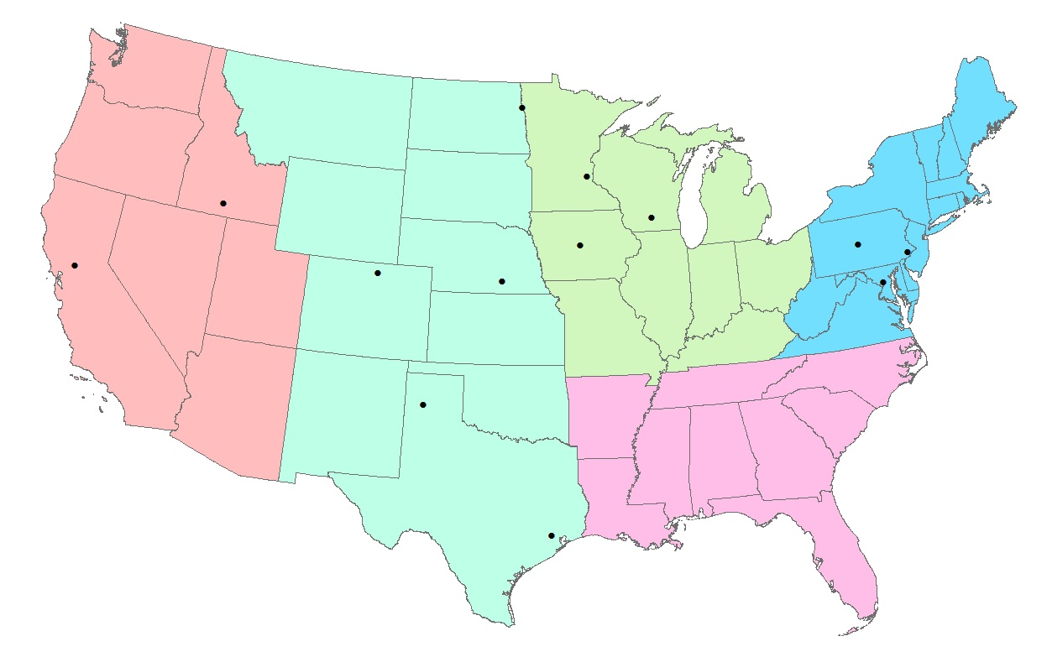
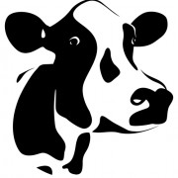
Figure 1A: The Dairy Grand Challenge Project (DAPP) Illustrated – Participant Map and Research Focus
Dairy for People & the Planet DAPP Research Sites
St. Paul (SWMR/PSR)
Soils, Forages
Madison (USDFRC)
Dairy Nutrition, Genetics, Microbiome, Soils, Forages
Grand Forks (GFHNRC)
Human Nutrition
Kimberly (NWISRL)
Soils, Air and Water
Clay Center (USMARC)
Microbiome, Nutrition, Soils
University Park (PSWMR) Soils, Forages, LTAR
Ames (NLAE)
Soils, Water, LTAR
Davis (WHNRC)
Human Nutrition
Fort Collins (SMSBR)
Soils, Air and Water, NUOnet
Beltsville (AGIL)
Dairy Genetics, Nutrition
Wyndmoor (ERRC)
Human Nutrition, Food Safety
Bushland (CPRL)
Soils, Air and Water
Beltsville (BHNRC)
Human Nutrition
Houston (CNRC)
Human Nutrition
Photo credit: CA Milk Marketing Board

Slide 3
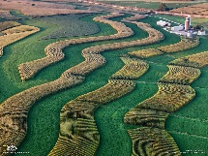
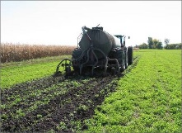
Figure 2: The Dairy Grand Challenge Project (DAPP) Illustrated – A Discover Model for Integrated Dairy Systems
Global Objectives
Develop sustainable dairy food production systems that improve human health and well-being.
Understand the GEM(S) iterative relationships among soils, forages, cows and dairy products.
Improve the productivity, efficiency, and sustainability of dairy systems on a landscape scale.
Identify system inefficiencies (leaks) and develop multi-disciplinary research based strategies to address them.
Determine how public health related to dairy is influenced by integrated dairy production systems.
Dairy product research
Nutritional value of milk for human health
Novel milk products
Economic value of milk products on-farm
Externalities
climate change, land price, competition, regulation , water limitations, energy costs
Leaks
forage loss, feed quality, metabolic loss, forage & cow production, efficiency
Leaks
nutritional value of milk, human health, novel products, consumer demand
Better cows
Better milk
Forage research
Forage systems that protect and enhance ecosystems
Forage breeding, production and management to optimize cow performance and efficiency
Economic values for ecosystem services provided by forages
Better forages
Better cows
Dairy cow research
Milk production and quality
Feed and production efficiency
Nutritional value of milk
Animal health and well-being
Manure management/recycling
Sustainable Dairy Production Systems for Human Health and Well-being
Externalities
climate change, weather, competition, regulation, nutrient availability, public demand, water limitations
Better soils
Better forages
Better cows
Better soils
Externalities
climate change, competition, regulation, consumer demand
Leaks
soil erosion, organic C and nutrients losses; air & water quality; GHG emissions
Leaks
soil health, nutrient loss, water quality, pathogens, odors, GHG emissions
Soil health/ecology research
Soil health and resilience, soil carbon
Nutrient cycling, N and P retention and utility
Soil erosion and water quality
Understanding the challenges & opportunities for dairy production systems research.
Photo credit: CA Milk Marketing Board, National Geographic.

Slide 4
Figure 3: The Dairy Grand Challenge Project (DAPP) Illustrated – Providing Ecosystem Services from Dairy
Millennium Ecosystem Assessment
Provisioning services – food, raw materials, genetic resources, water, biogenic minerals, medicinal resources, energy, and ornamental resources.
Regulating services – climate regulation, carbon sequestration, waste decomposition and detoxification, water and air purification, and pest and disease control.
Cultural services – cultural, spiritual and historic, recreation, aesthetic, and science and education, and therapeutic benefits.
Supporting services – primary production, soil formation, photosynthesis, and nutrient cycling
Dairy product research
Provisioning Services
food, raw materials (fodder, organic matter, fertilizer), biogenic minerals, genetic resources
Better cows
Better milk
Provisioning Services
food, raw materials
Cultural Services
cultural value, historical, science and education, therapeutic
Dairy forage research
Better forages
Better cows
Provisioning Services
food crops, raw materials (fodder, organic matter, fertilizer), biogenic minerals, genetic resources
Dairy cow research
Sustainable Dairy Production Systems for Human Health and Well-being
Provisioning Services
raw materials (organic matter, fertilizer), biogenic minerals, energy
Better soils
Better forages
Better cows
Better soils
Support/Regulating Services
nutrient cycling, soil formation, carbon sequestration, climate regulation, water quality, pest/disease control
Support/Regulating Services
nutrient cycling, soil formation, carbon sequestration
Soil health/ecology research
Understanding the Ecosystem Services provided, or required, by dairy production systems.
Photo credit: CA Milk Marketing Board, National Geographic.

Slide 5

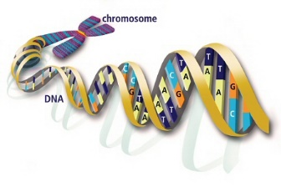
Figure 4: The Dairy Grand Challenge Project (DAPP) Illustrated – A “Systems Biology” Model for Integrated Dairy Systems
Global Objectives
Develop sustainable dairy food production systems that improve human health and well-being.
Understand the GEM(S) iterative relationships among soils, forages, cows and dairy products.
Improve the productivity, efficiency, and sustainability of dairy systems on a landscape scale.
Identify system inefficiencies (leaks) and develop multi-disciplinary research based strategies to address them.
Determine how public health related to dairy is influenced by integrated dairy production systems.
Dairy – consumer ecology interface
Human genotype (gene expression) by dairy product interactions
Human microbiome interactions with dairy products and human health
Human socio-economic demands for dairy production
Forage genetic and microbiome influences
Dairy cow genetic and microbiome influences
Human genetic, health, microbiome and nutritional ecology influences
Forage – dairy systems ecology interface
Forage genetic by dairy cow interactions
Forage microbiome influence on forage quality, soil health, and the dairy cow
Dairy cow forage digestibility and microbiome influences
The Living Ecology of Sustainable Dairy Systems
Follow the DNA!
Dairy cow – systems ecology interface
Dairy cow genotype and gene expression by production system interactions
Rumen and gut microbiome by production system interactions and adaptation
Dairy cow health and well-being by environmental microbiome interactions
Forage genetic, health and microbiome influences
Soil microbial and
pathogen parasite influences
Dairy cow manure microbiome influences
Soil microbiome influences
Soil health – systems ecology interface
Soil microbiome influence on forage health, production & quality
Soil microbial genetics influence on soil health, parasites, pathogens and nutrient cycling efficiency
Soil microbiome by dairy manure nutrient and microbiome interactions
Understanding the systems biology or “living ecology” of dairy production systems.
Photo credit: National Geographic.

